Slide 1
Introduction To
OSI Model

Slide 2
Data Communication
The word data refers to information presented in whatever form is agreed upon by the parties creating and using the data.
Data communications are the exchange of data between two devices via some form of transmission medium such as a wire cable.
The main focus in Data Communication Course
  Detail study of Physical Layer i.e., Signals, topologies, Line Encoding, Modulation / Demodulation, Multiplexing, Circuit Switching
  Some topics in Data Link Layer like Flow Control, Error Detection and Control

Slide 3
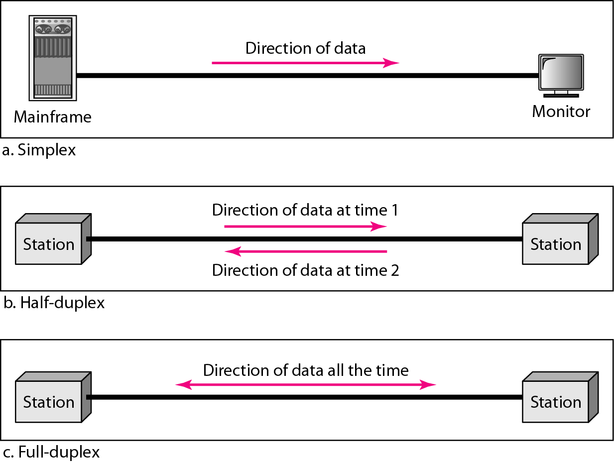
Direction of Data Flow
Simplex – unidirectional; one transmits, other receives
Half-duplex – each can transmit/receive; communication must alternate
Full-duplex – both can transmit/receive simultaneously

Slide 4
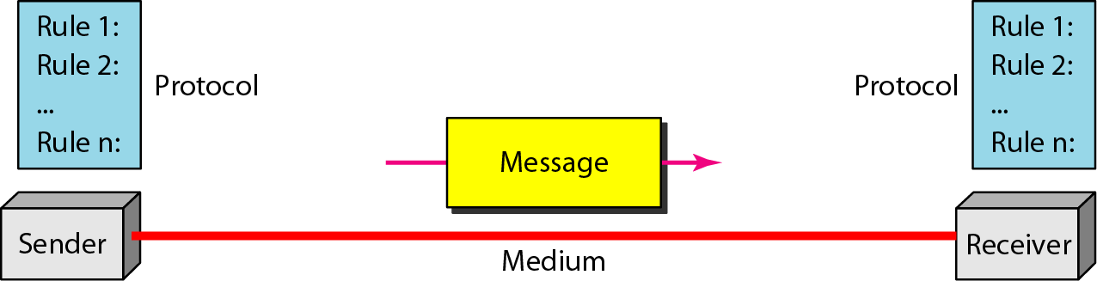
5 Components of Data Communication
Sender
Receiver
Message
Medium
Protocols
Effectiveness depends on:
  Delivery, Accuracy, Time

Slide 5
Data Representation
Text – represented as a bit pattern; codes often used:
Numbers – represented by binary equivalent
Images – bit patterns representing pixels
Audio
Video

Slide 6
Networks
Set of devices (nodes) connected by media
Sharing of Resources
Distributed processing
Network Criteria
  Performance – affected by # users, type of medium, HW/SW
  Reliability – Measured by freq of failure, recovery time, Vulnerability
  Security – Protection from unauthorized access, viruses/worms

Slide 7
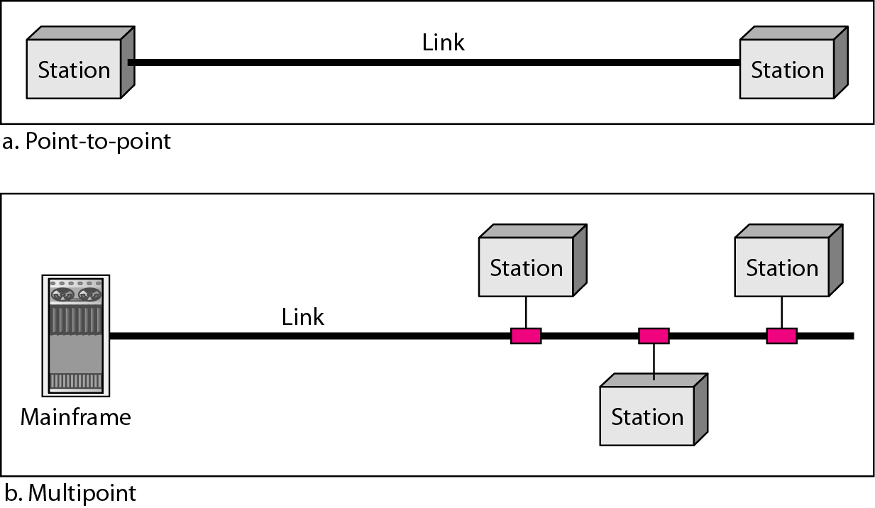
Types of Connections

Slide 8
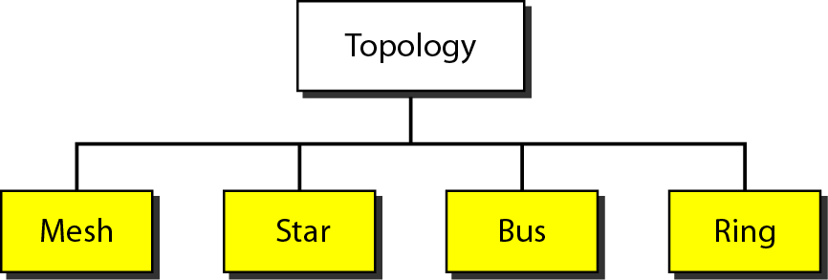
Topology
Physical or logical arrangement
4 basic types: mesh, star, bus, ring
May often see hybrid

Slide 9
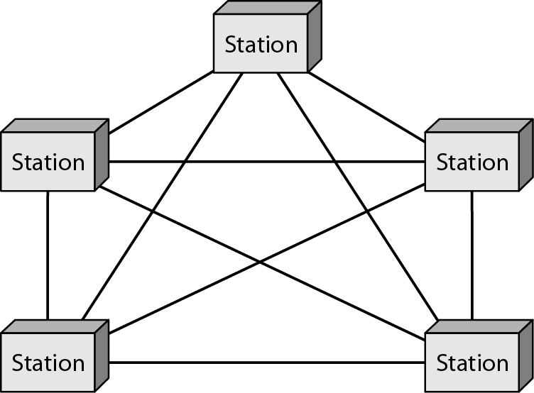
Mesh Topology
Dedicated point-to-point links to every other device
n(n-1)/2 physical channels to link n devices
Every device on network must have n-1 I/O ports
Advantages: Dedicated links, Robust, Security and privacy, Easy fault identification and isolation
Disadvantages: Bulk of wiring, No of I/O ports, expensive, Difficult installation and reconnection

Slide 10
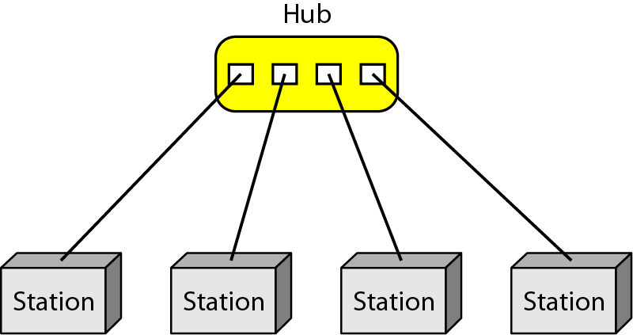
Star Topology
Dedicated point-to-point links to central controller (hub)
Controller acts
as exchange
Advantages: Less expensive then mesh, Easy to install and configure, robustness, easy fault isolation and identification
Disadvantages: More cabling required then ring and bus

Slide 11
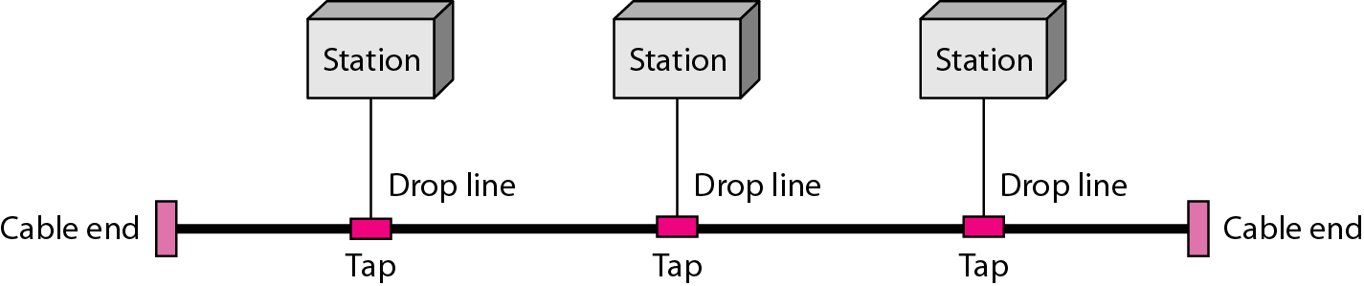
Bus Topology
Multipoint configuration
One cable acts as a backbone to link all devices
Advantages: Less cabling, Easy to install and reconfigure
Disadvantages: Limited no of taps supported, Difficult reconnection and fault isolation, Break in bus cable stops all transmision

Slide 12

Ring Topology
Dedicated point-to-point configuration to neighbors
Signal is passed from device to device until it reaches destination
Each device functions as a repeater
Advantages: Less cabling, Easy to install and reconfigure
Disadvantages: Break in the ring and disable entire network

Slide 13
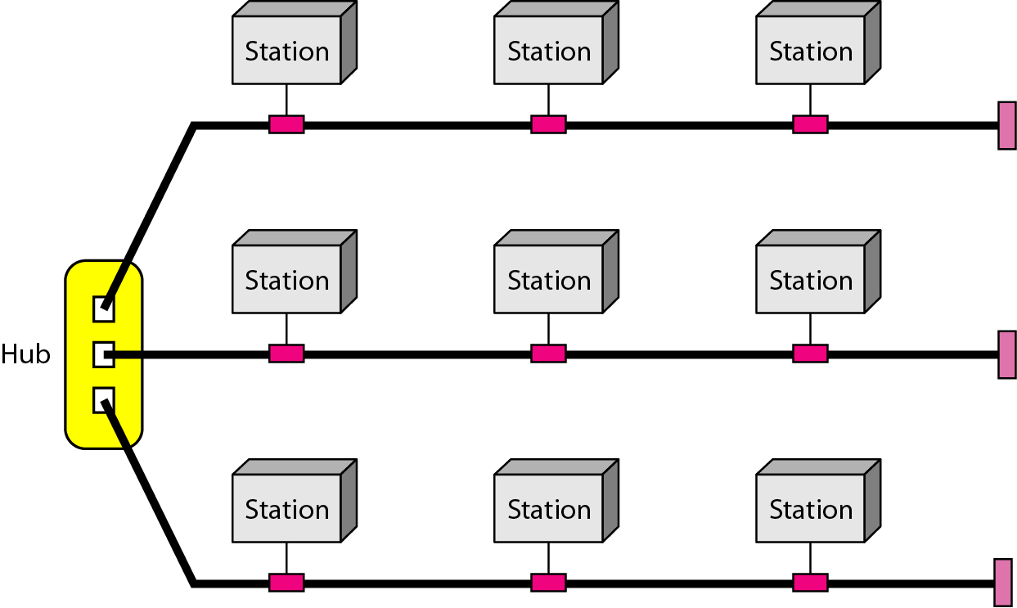
Hybrid Topology

Slide 14
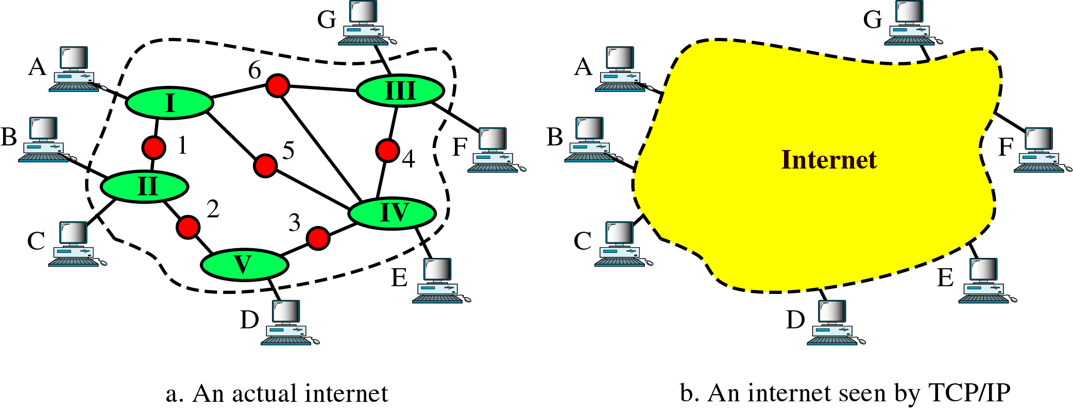
Internetworks
Connection of two or more networks
Internet vs. intranet

Slide 15
The Internet
Collaboration of more than hundreds of thousands of interconnected networks
1969 – started as ARPAnet, a small network of connected computers
1972 - Cerf and Kahn – packet delivery and Transmission Control Protocol (TCP)
Shortly thereafter – evolution of TCP/IP

Slide 16
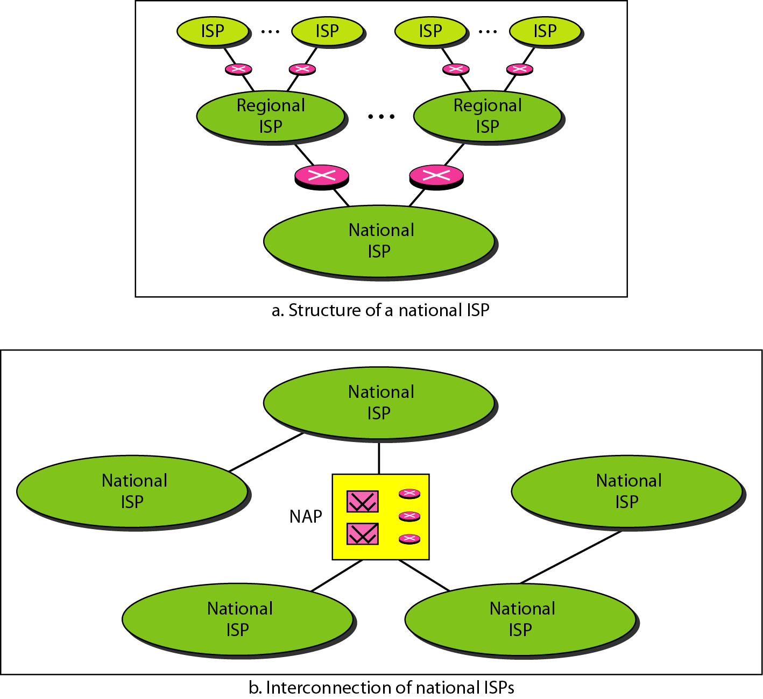
Hierarchical organization of the Internet

Slide 17
Protocols and Standards
Why do we need them?
Protocol – set of rules that govern data communication; defines what, how, and when
  Key elements – syntax, semantics, timing
  Syntax: structure / format of data
  Semantics: meaning of each section of bits
  Timing: when and how fast data should be sent
Standard – provides a model for development; allows for interoperability

Slide 18
Standards
Types –
  De jure/Formal (by law/regulation) – legislated by an officially recognized body
  De facto (by fact/convention) – by convention or widespread use
Standards Organizations – committees, forums, regulatory agencies
ISO, ITU-T, ANSI, IEEE, EIA are some of the organizations involved with standards creations
Internet Standards
  Drafts (working document …. In progress …)
  RFC Process (published draft)

Slide 19
Layered Tasks
We use the concept of layers in our daily life.
As an example, let us consider two friends who communicate through postal mail.
The process of sending a letter to a friend would be complex if there were no services available from the post office.

Slide 20
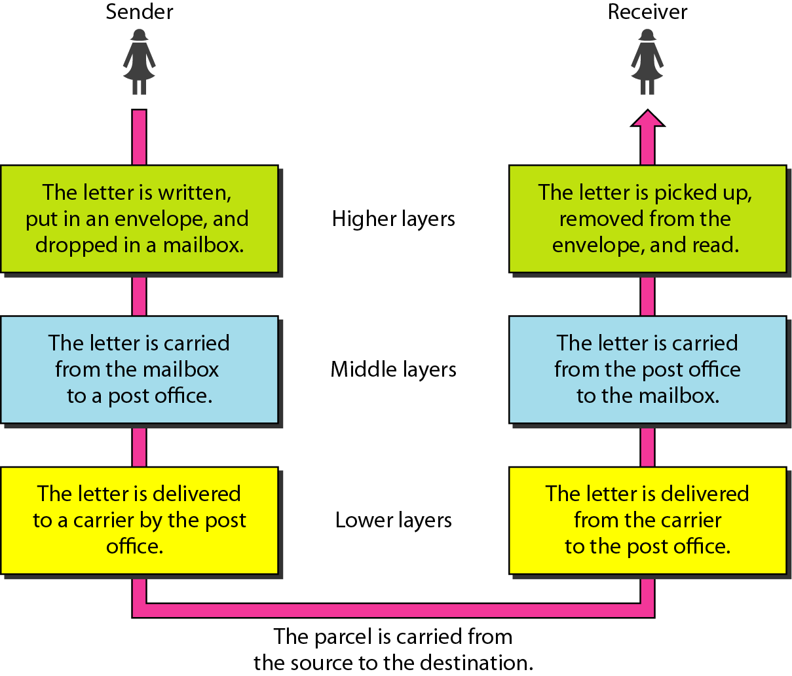
Tasks involved in sending a letter

Slide 21
The OSI Model
International Standards Organization (ISO) is a multinational body dedicated to worldwide agreement on international standards.
An ISO standard that covers all aspects of network communications is the Open Systems Interconnection (OSI) model.
It was first introduced in the late 1970s
ISO is the organization
OSI is the Model

Slide 22
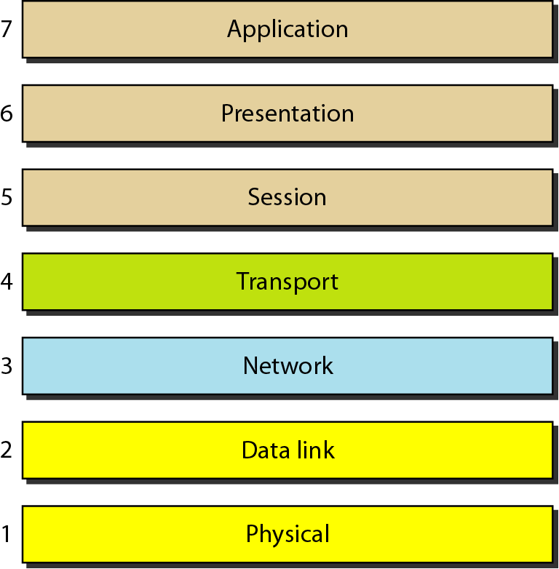
Seven layers of the OSI model

Slide 23
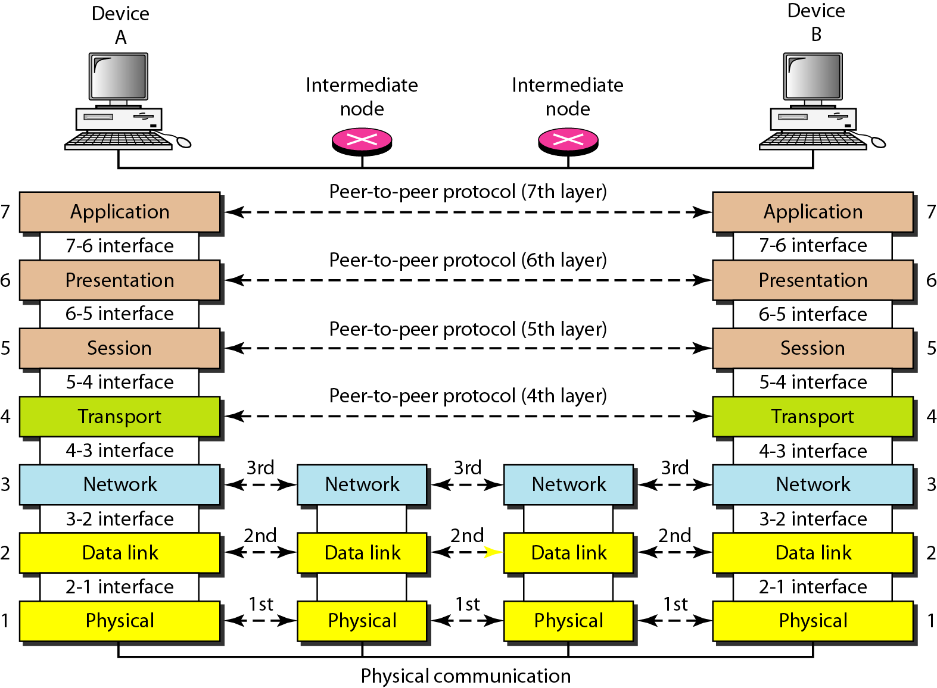
The interaction between layers in the OSI model

Slide 24
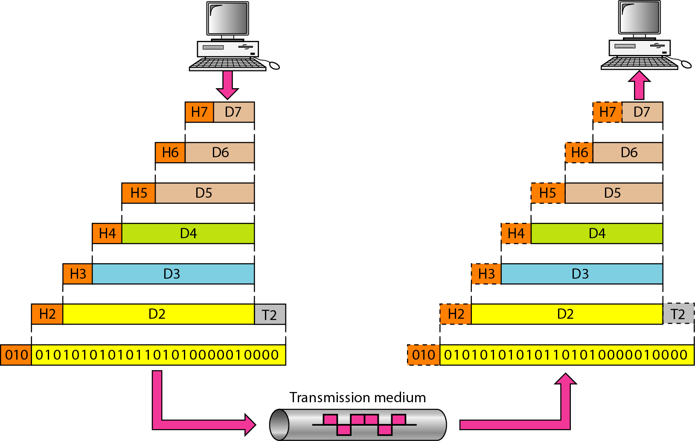
An exchange using the OSI model

Slide 25
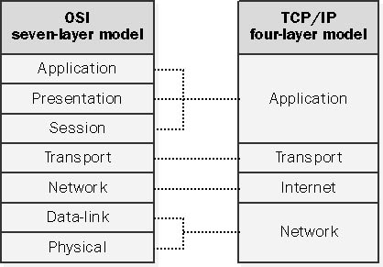

Slide 26
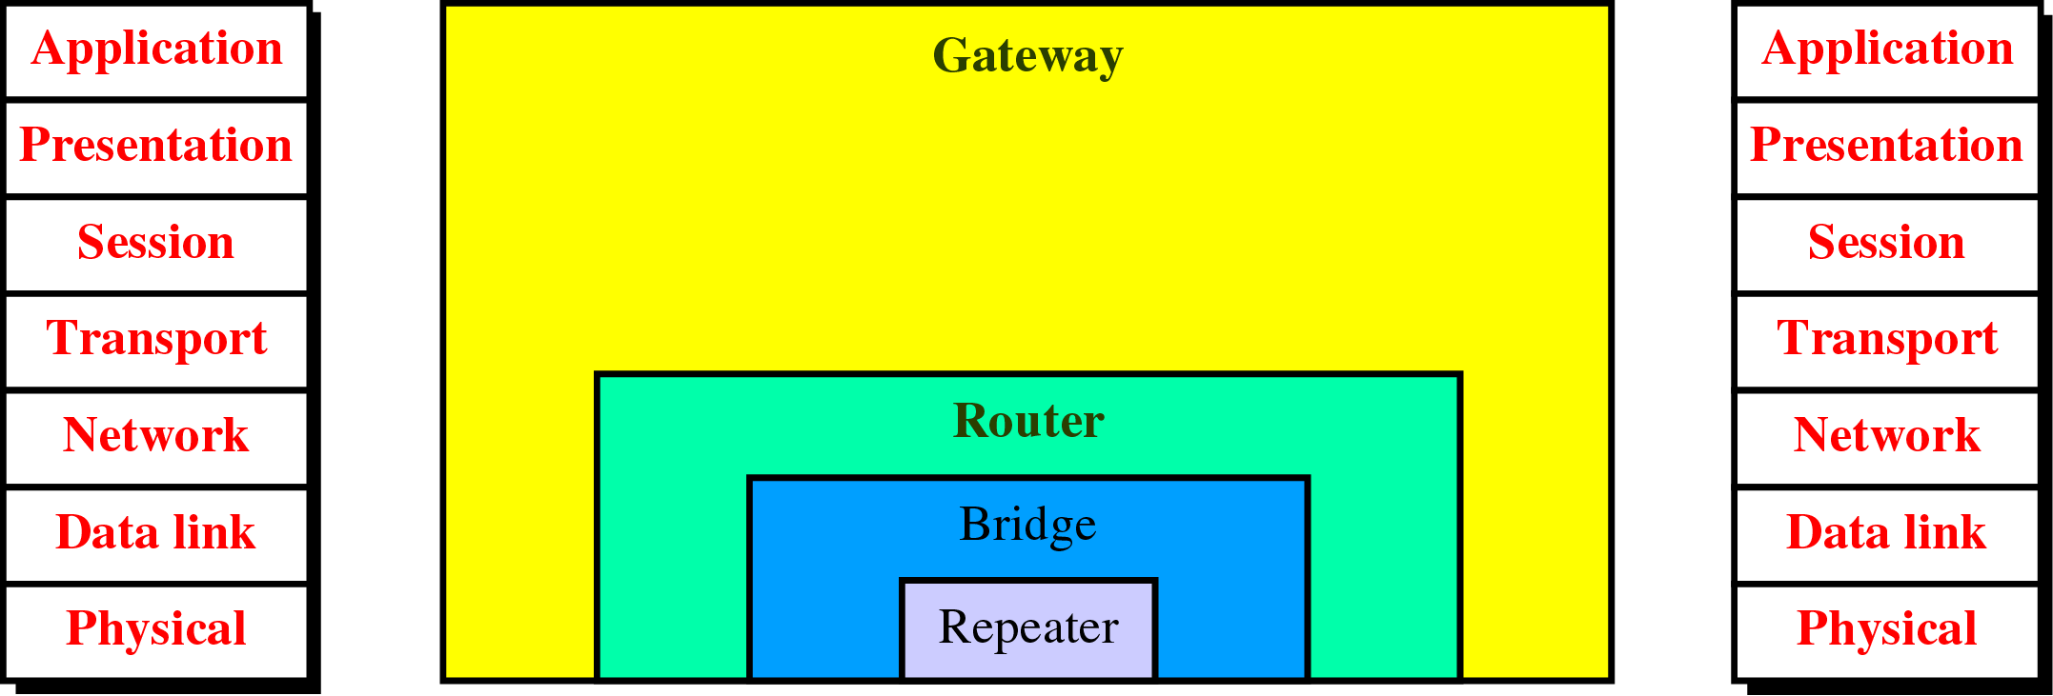
Figure 21-2
Connecting Devices and the OSI Model

Slide 27
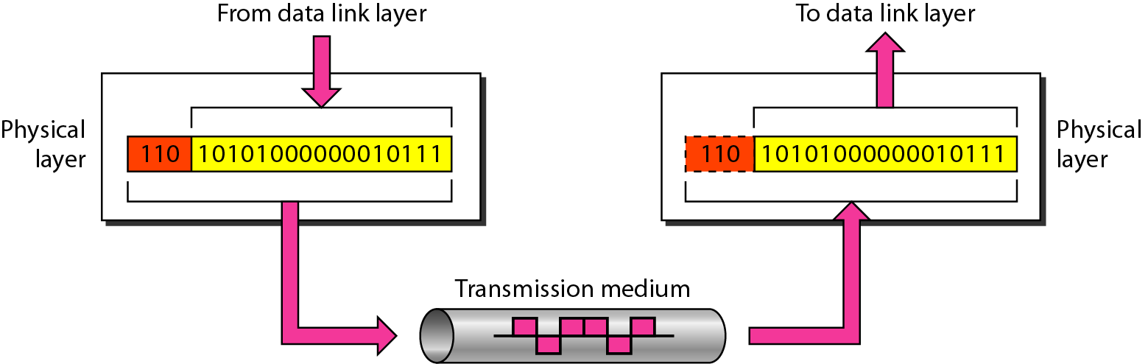
Physical Layer
The Physical layer is responsible for transmitting
individual bits from one node to the next

Slide 28
Duties of Physical Layer
Physical characteristics of interfaces and media
Representation of bits
  Bits must be encoded/modulated
Data rate
  Define duration of bit
Synchronization of bits
  Sender/Receiver must be synchronized at bit level

Slide 29
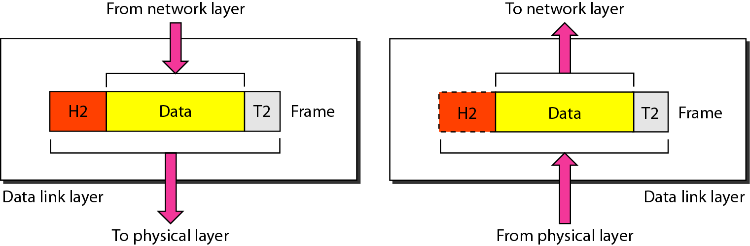
Data Link Layer
Hop-to-hop or Node-to-node delivery
The data link layer is responsible for transmitting frames from one node to the next

Slide 30
Duties of Data Link Layer
Framing
Physical addressing (MAC)
Flow Control
  To prevent overwhelming the receiver
Error Control
Access Control

Slide 31
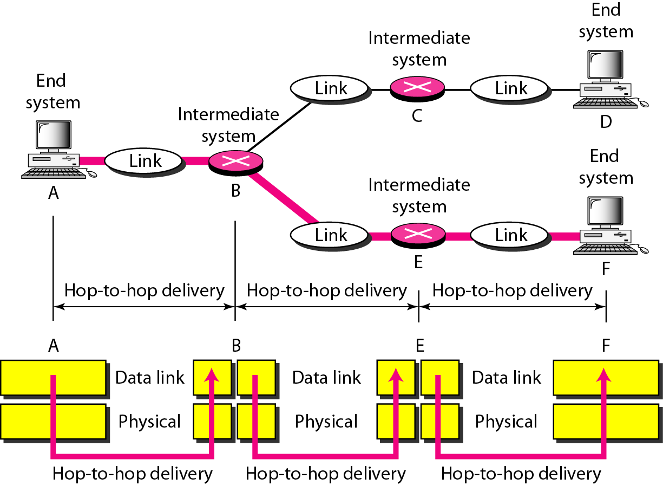
Hop-to-hop delivery

Slide 32
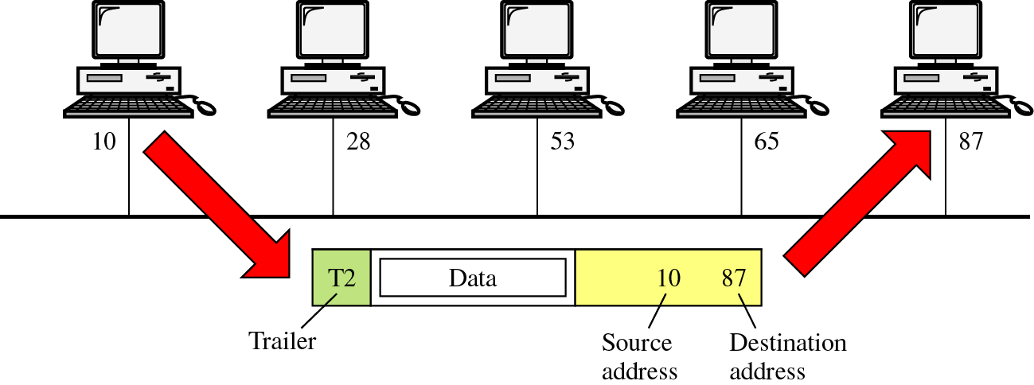
Data Link Layer Example

Slide 33
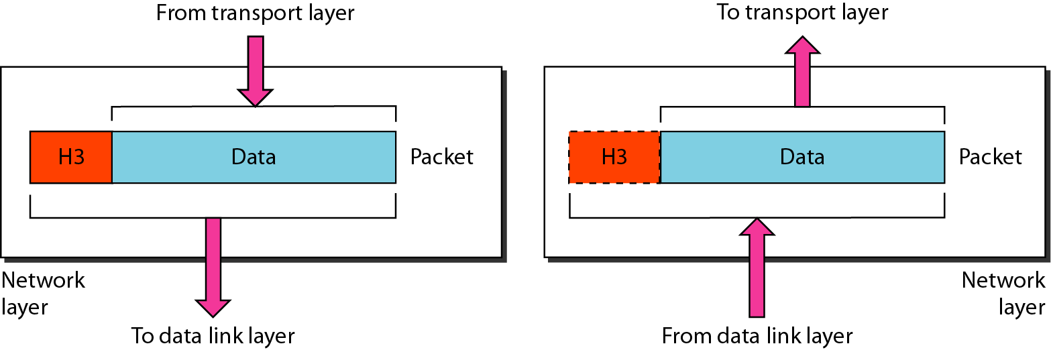
Network Layer
The network layer is responsible for the
delivery of individual packets from
the Source host to the Destination host

Slide 34
Duties of Network Layer
Network Layer is responsible for the delivery of packets from the original source to the final destination
Logical addressing (IP)
Internetworking
Routing

Slide 35
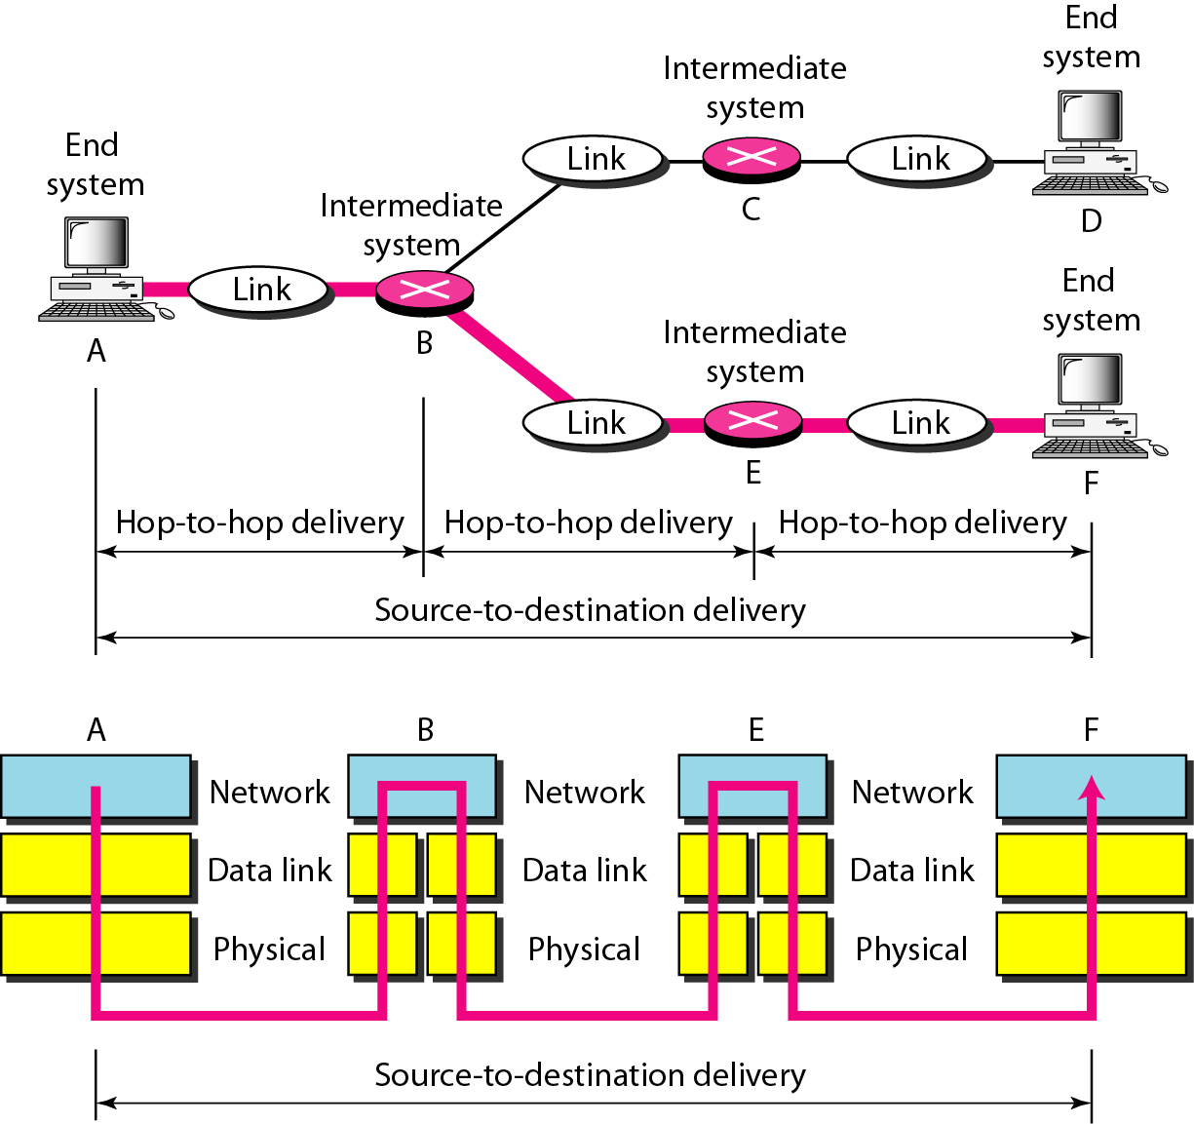
Source-to-destination delivery

Slide 36
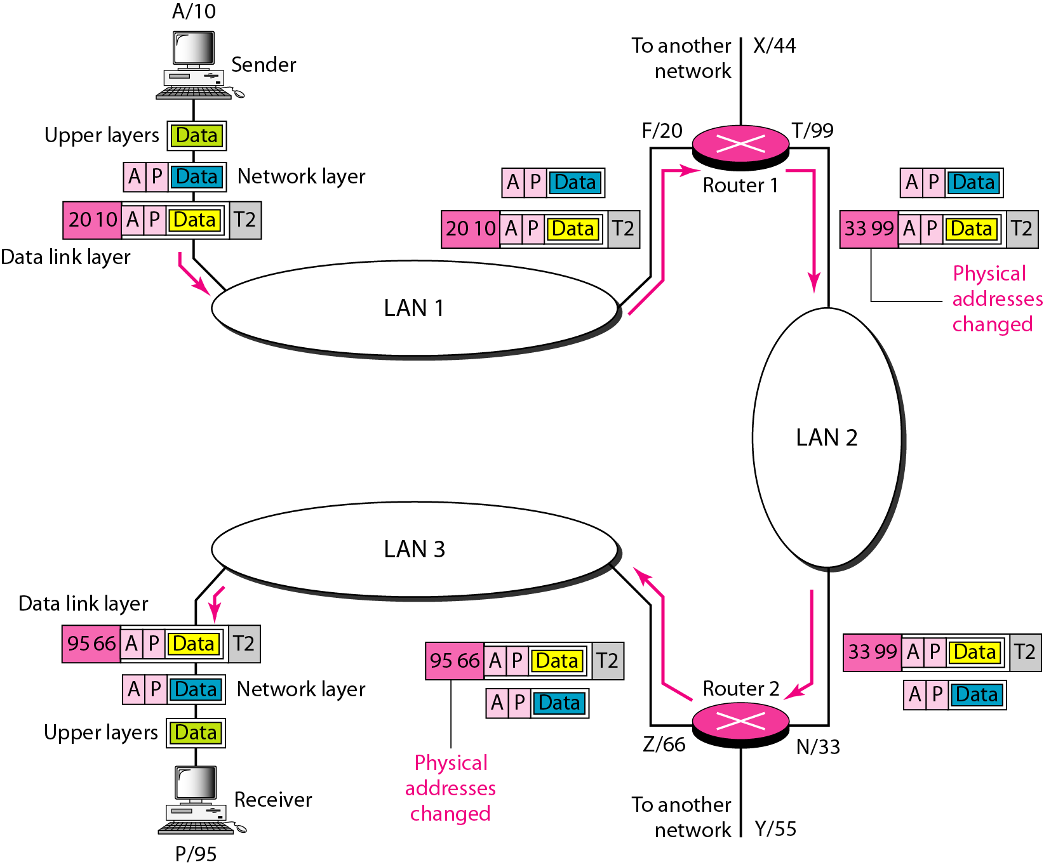
Network Layer Example

Slide 37
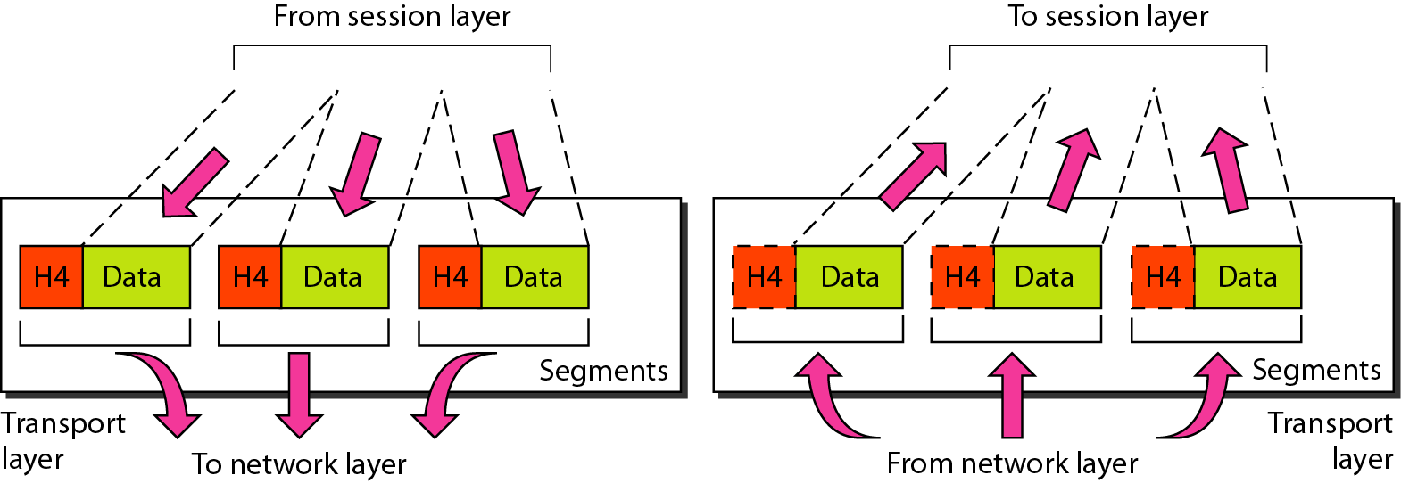
Transport Layer
Process-to-process or End-to-end Delivery
The transport layer is responsible for the delivery
of a message from one process to another.

Slide 38
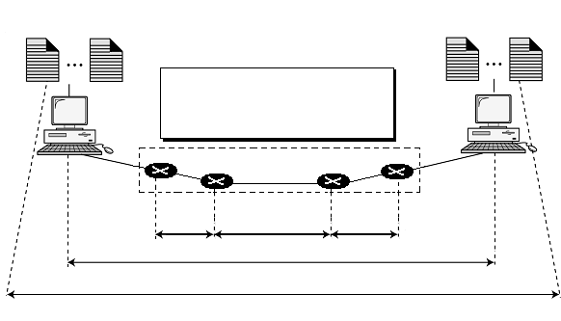
Process to Process Delivery
Processes
(Running application programs)
Processes
(Running application programs)
Node-to-node: Data Link Layer
Host-to-host: Network Layer
Process-to-process: Transport Layer
Internet
Node-to
-node
Node-to
-node
Node-to-node
Host-to-host
Process-to-process

Slide 39
Duties of Transport Layer
Process-to-process delivery of entire message
Port addressing
Segmentation and reassembly
Connection Control
Flow Control
Error Control

Slide 40
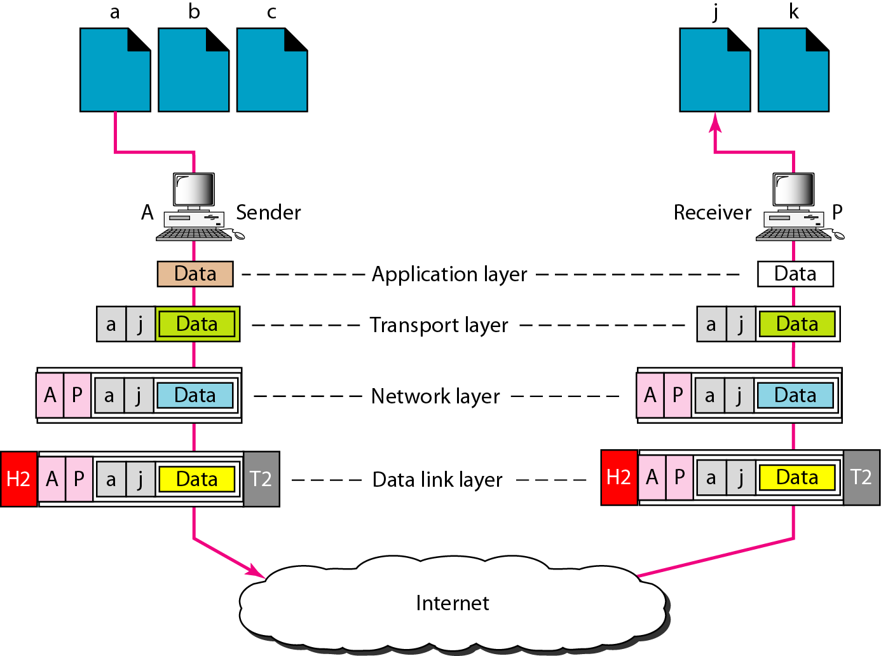
Transport Layer Example

Slide 41
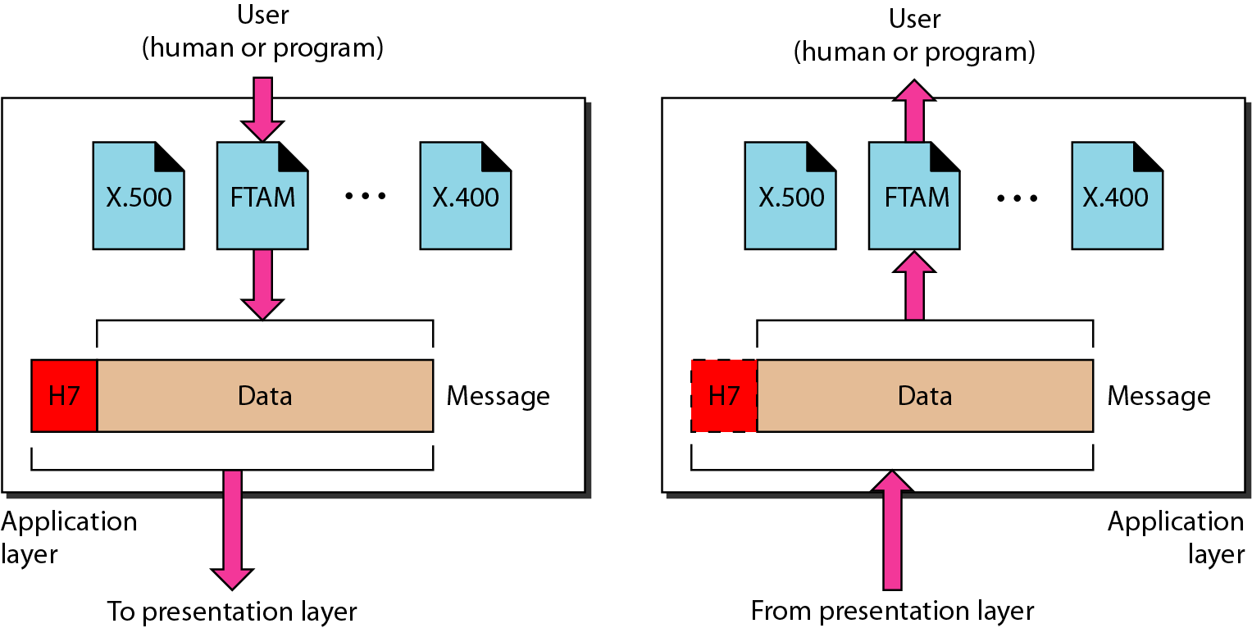
Application Layer
The application layer is responsible for providing
services to user, whether human or software

Slide 42
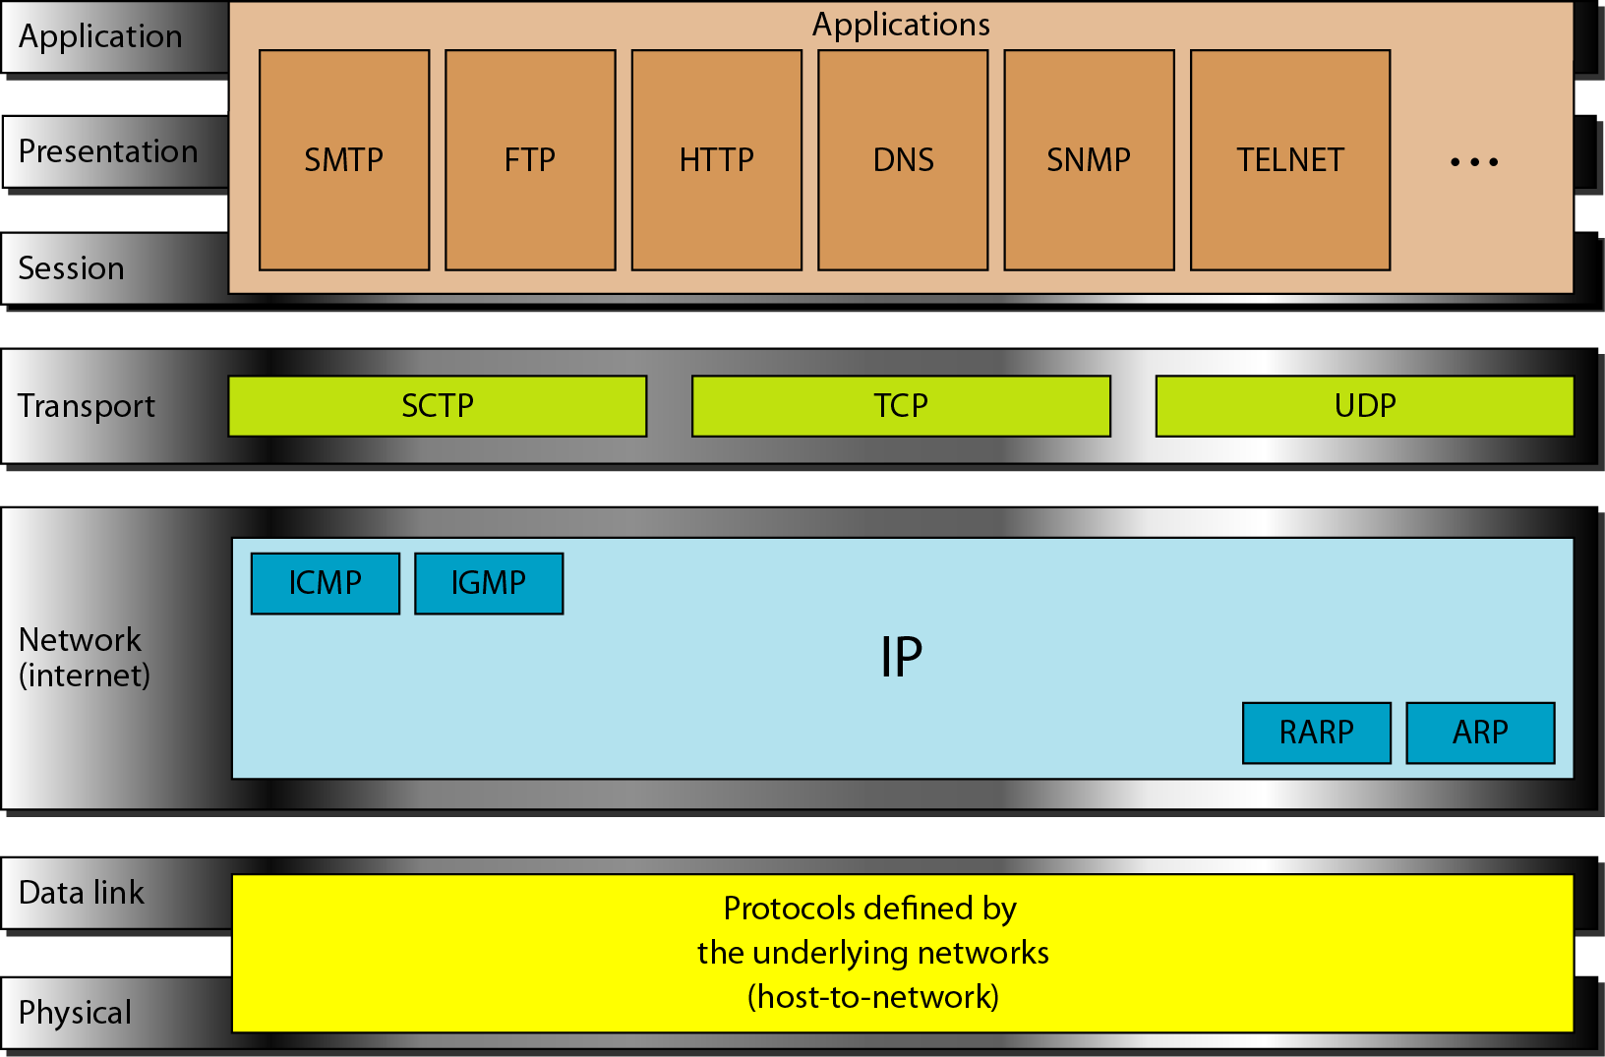
TCP/IP and OSI model

Slide 43
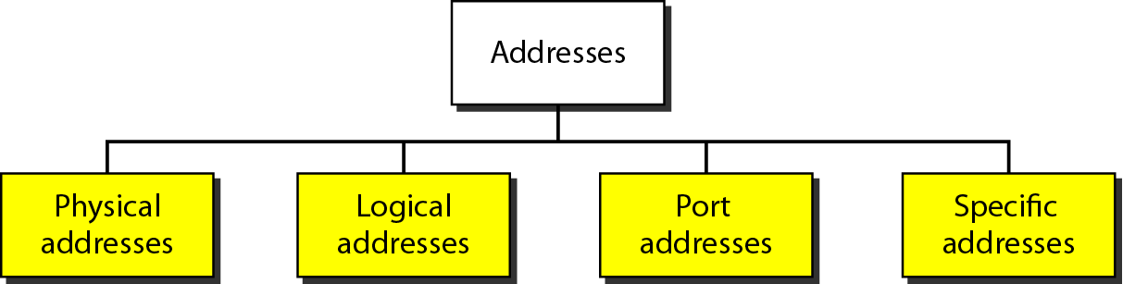

Slide 44
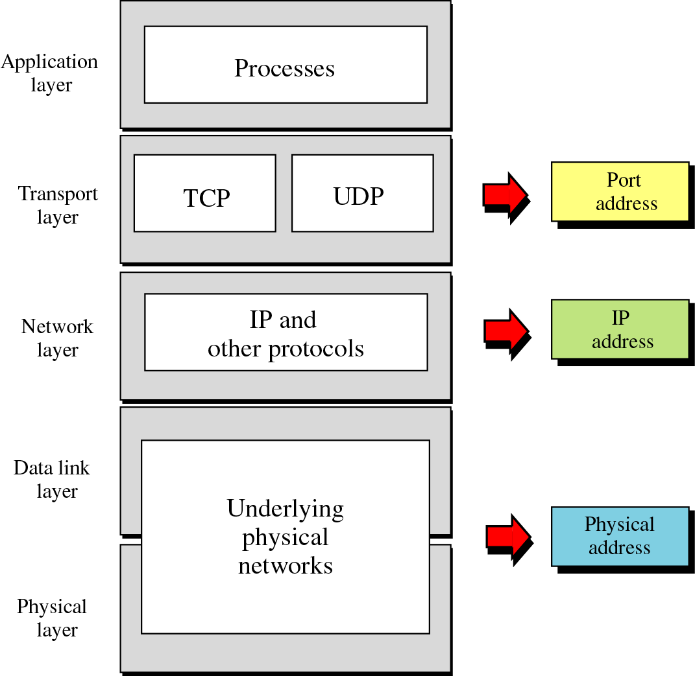

Slide 45
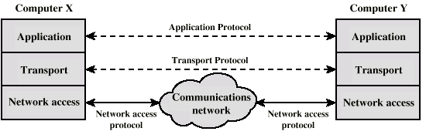
Protocols in Simplified Architecture

Slide 46
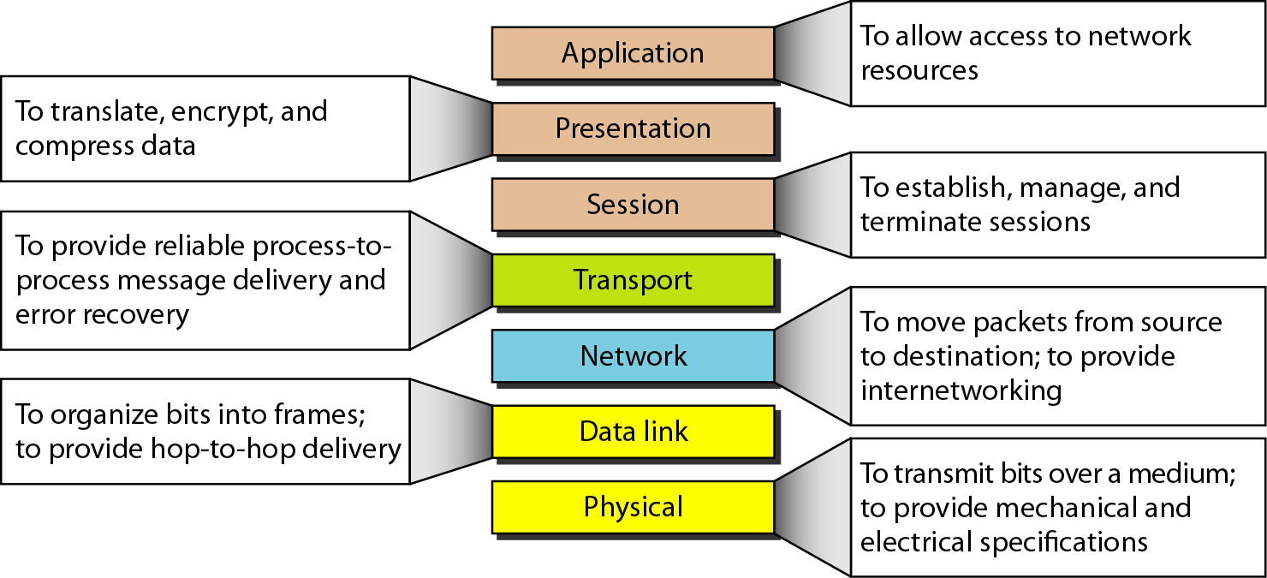
Summary of Layer Functions

Slide 47
Review Questions
What are the three criteria necessary for an effective and efficient network?
Identify the five components of data communication system?
What are the advantages of distributed processing?
What is the difference between simplex, half duplex and full duplex transmission modes?
Explain the different form of data representations.
Explain the three categories of Computer Networks.
What are the advantages of a multipoint connection over a point to point connection?

Slide 48
Review Questions
What are the two types of line configuration?
Name the four basic network topologies, and give advantages and disadvantages for each type?
What is an internet? What is the Internet?
Explain the process of Internet Standard creations?
Why are protocols needed?
Why are standards needed? What are the two categories of Standards?
Explain the role of following Standards Organizations in creation of Network Standards
ISO, ITU-T, ANSI, IEEE, EIA

Slide 49
Review Questions
What are the duties of Physical Layer?
What are the duties of Data Link Layer?
What are the duties of Network Layer?
What are the duties of Transport Layer?
What is the difference between Network Layer delivery and Transport Layer delivery?
What are headers and trailers, and how do they get added and removed?
What is the difference between a port address, a logical address, and a physical address?
Name some services provided by the application layer.
Give one line explanation of each layer of OSI Model

